Slide 1
Lecture 1.3 ​- Why is Data Science Important?
DLI Accelerated Data Science Teaching Kit

Slide 2

The Accelerated Data Science Teaching Kit is licensed by NVIDIA, Georgia Institute of Technology, and Prairie View A&M University under the
Creative Commons Attribution-NonCommercial 4.0 International License.

Slide 3
Why is Data Science Important?

Slide 4
Why is data science important?
Data Science unlocks potential of data in solving societal challenges and large-scale complex problems across domains, from business, technology, science, engineering, healthcare, to government, and many more.
As data continues to grow in volume, velocity and complexity, there is a strong demand for data science talents to help design the best solutions.

Slide 5
Why is data science important?
“Data, and the capability to extract useful knowledge from data, should be regarded as key strategic assets” — Data Science for Business
Data-analytic thinking helps you
Assess whether and how data can address a problem
Envision opportunities for data-driven decision making
See data-oriented competitive threats
Important to understand data science even if you never intend to apply it yourself!

Slide 6
What are the “ingredients” of data science?
Need to consider: storage, complex system design, scalability of algorithms, statistical tests, visualization techniques, interaction techniques, etc.
Above issues often become more complex with big data.

Slide 7
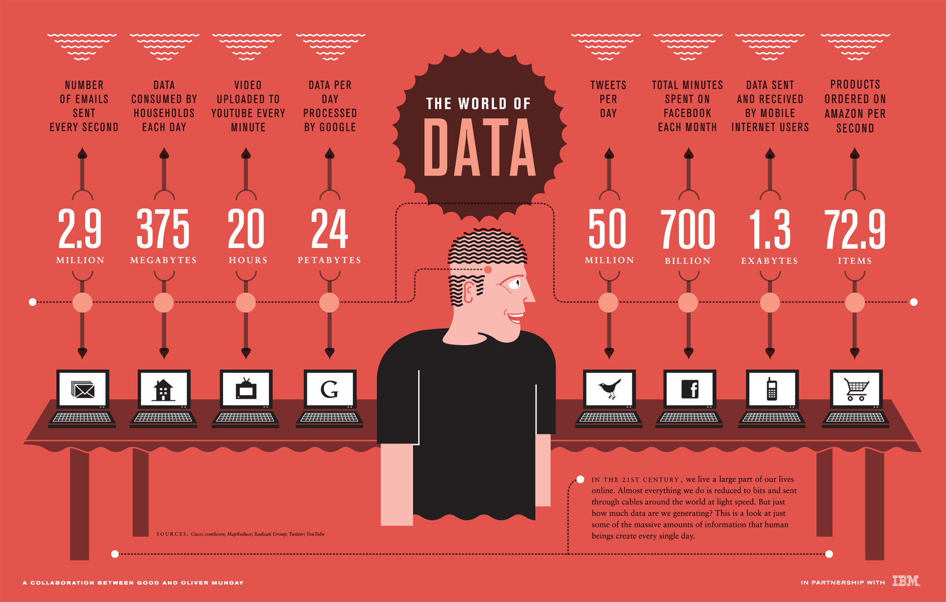
RETRIEVED from: https://www.good.is/infographics/the-world-of-data-we-re-creating-on-the-internet. October 9, 2017
(Einstein might or might not have said this.)

Slide 10
DLI Accelerated Data Science Teaching Kit
Thank You

